Slide 1
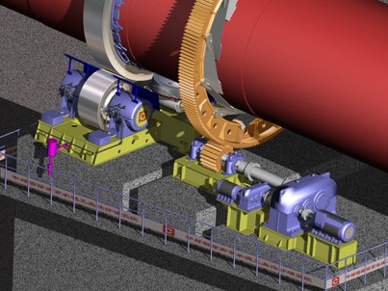
Kiln Mechanical Inspection
Daily Inspection Check Points
Weekly Inspection Check Points
Semiannually Inspection Check Points
Annual Inspection Check points
Monthly Inspection Check Points

Slide 2
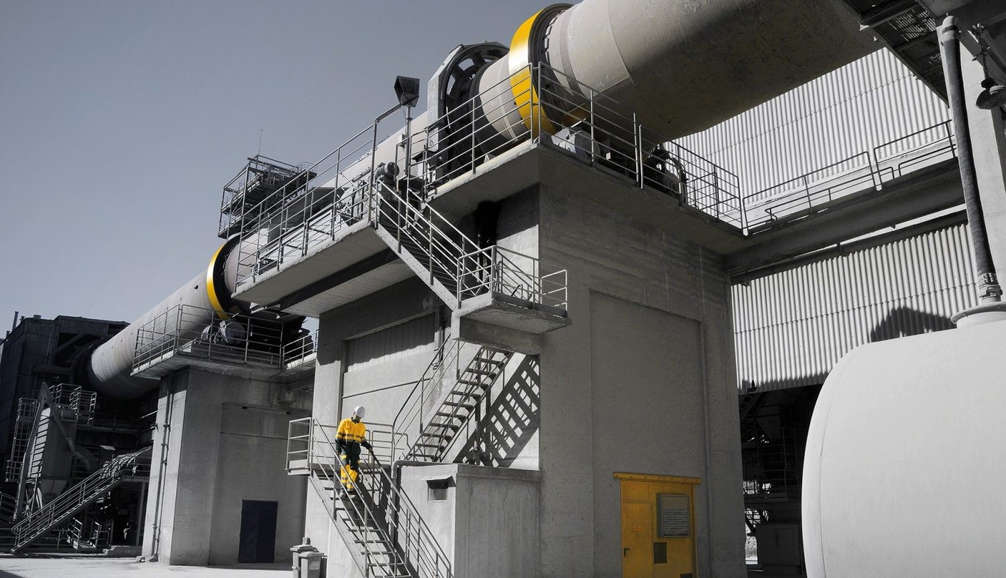
Daily Inspection Check Points
Check the kiln end seals for any abnormal product leakage.
Measure the shell temperature across the circumference on uphill and downhill side of the heavy shell section located under tire and also inspect the kiln shell section in between piers for any discoloration or hot spot.
Observe and document any unusual wear patterns in the tires and trunnions.
Check for any cracked or missing tire retaining hardware.
Check the trunnion roller shaft temperature through inspection port provided at the top of the bearing housing for any abnormal heat. Check bearing water cooling jackets for the proper flow of coolant (water).

Slide 3
Daily Inspection Check Points
Check the kiln end seals for any abnormal product leakage.
Measure the shell temperature across the circumference on uphill and downhill side of the heavy shell section located under tire and also inspect the kiln shell section in between piers for any discoloration or hot spot.
Observe and document any unusual wear patterns in the tires and trunnions.
Check for any cracked or missing tire retaining hardware.
Check the trunnion roller shaft temperature through inspection port provided at the top of the bearing housing for any abnormal heat. Check bearing water cooling jackets for the proper flow of coolant (water).

Slide 4
Weekly Inspection Check Points
Measure the relative motion between tire and shell/ Creep and also record the tire temperature.
Check the trunnion roller bearing oil levels.
Check the oil level in kiln thrust device.
Inspect the gear and pinion lubrication system and ensure there is adequate lubrication and the entire width of the teeth is being lubricated.
Observe any movement or damage to the support bases and anchor bolts.

Slide 5
Weekly Inspection Check Points
Check graphite for proper lubrication, i.e. free in their holders, no grease, or oil on the riding surfaces.
Observe and document the axial balance of the kiln, i.e. on the uphill or downhill thrust rollers, or in between. Check for wear on the thrust faces of the tire and thrust rollers.
Check temperature of the thrust roller housing
Observe and document any unusual noises or vibrations from the drive train.

Slide 6
Monthly Inspection Check Points
Observe and document the condition of the gear spring plates, flange mounts, and splice bolts (Look for any air bubbles at joints).
Check the gear and pinion teeth face for any unusual contact patterns and wear.
Lubricate drive couplings.
Observe, document, and operate the auxiliary drive.

Slide 7
Semi-Annual Inspection Check Points
Mechanical Audit
Measure shell ovality
Adjust the trunnion roller skew to reduce uneven wear on bearing liners
Perform oil analysis on trunnion roller bearings and main gear.
Check Main drive gear box oil for its chemical properties

Slide 8
Annual Inspection Check Points
Hot kiln Alignment and mechanical audit.
Replace Bearing Lubricant
Comprehensive trunnion roller bearing inspection.
Trunnion roller bearing water cooling lines Descaling
Removing the gear guard and performing an annual complete mechanical inspection of the gear which includes the following:
Checking the axial and radial alignment of the gear.
Measuring the gear root clearance and backlash.
Inspecting the gear spring plate pins for any abnormal wear/ checking the bolts if flange mounted.
Inspecting the gear spring plate welding joints for any cracks.
Inspecting the gear joint bolts.

