Slide 1
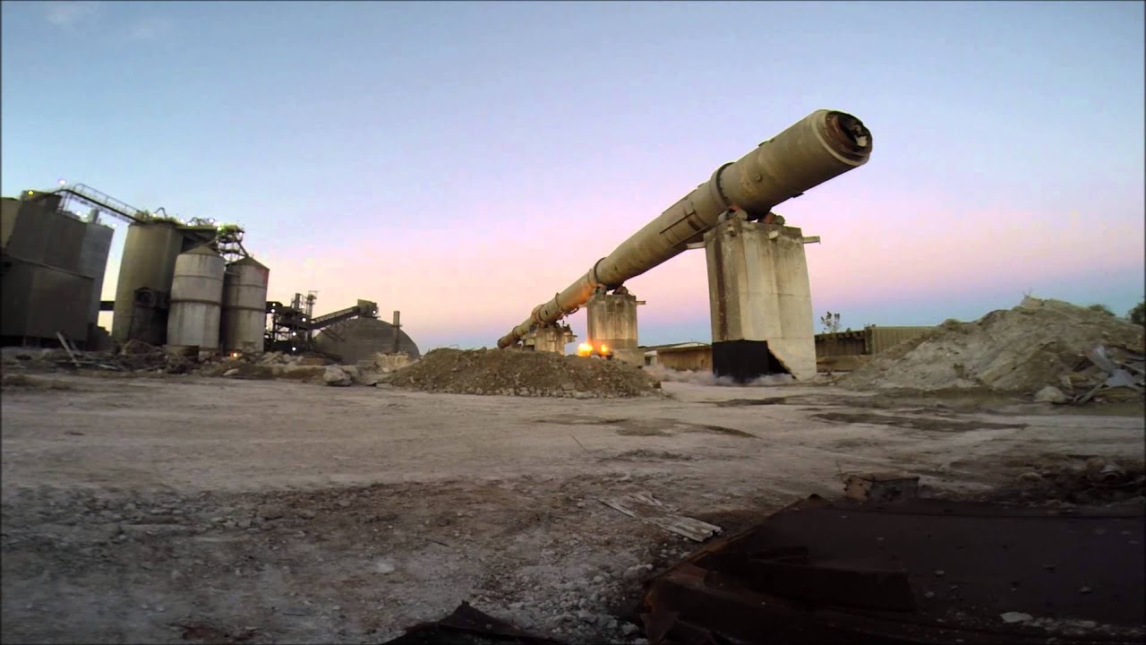
Kiln Maintenance Troubleshooting

Slide 2
High Bearing Temperature On Journal
Root Causes | Solution
Kiln Axis | Perform Hot Kiln Alignment
Kiln Crank / Dog leg | Remove dog leg by replacing shell sections / make correction cuts.
Lubrication | Maintain the correct oil level making sure not to overfill.
Scored Shaft | Replace the trunnion roller.

Slide 3
High Bearing Temperature On Journal
Root Causes | Solution
Tight Bearing Liners | Replace Bearings
Roller to Bearing Liner Misalignment | Shim Bearing housing
Insufficient flow of coolant | Check water cooling lines. Perform Anion Bearing D-Scale Scope of Work

Slide 4
High Bearing Temperature On Thrust Collar/ End cap thrust button
Root Causes | Solution
Excessive trunnion roller Skew | Correct the roller skew/ perform axial balance.
Lubrication | Install Graphite Blocks On Each Roller

Slide 5
High tire axial pressure on tire retaining hardware
Root Causes | Solution
Kiln Axis | Perform Hot Kiln Alignment
Improper Trunnion roller slope | Shim the trunnion roller bearing housings.
Tapered tire and trunnion roller working faces | Grind the working faces of tire and trunnion rollers.
Excessive Creep | Shimming / replacing the support pads (based on design)

Slide 6
High tire axial pressure on tire retaining hardware
Root Causes | Solution
Excessive trunnion roller thrust Lubrication | Perform Axial balance Use Anion Slick Spray Tire/Shell Interface

Slide 7
Refractory Failure under tire
Root Causes | Solution
Kiln Axis | Perform Hot Kiln Alignment
High Shell Ovality due to excessive tire creep | Shimming / replacing the support pads (based on design).

Slide 8
Refractory Failure in between piers
Root Causes | Solution
Kiln Crank / Dog leg | Perform Kiln Shell profile Analysis, locate dog leg and replace the shell sections.
Kiln Operation | Avoid frequent start and stops
Deformed Shell Section | Replace the deformed shell section.
Refractory Lining Quality | Use proper guide lines during installation of refractory lining.

Slide 9
Inconsistent High Main Drive Motor Amps
Root Causes | Solution
Kiln Axis | Perform Hot Kiln Alignment
Kiln mechanical Crank / Dog leg | Perform Kiln Shell profile Analysis, locate dog leg and replace the shell sections.
Kiln Thermal Crank | Avoid uneven product coating inside kiln.
Kiln Axial balance | Correct individual trunnion roller skew/ thrust.

Slide 10
Inconsistent High Main Drive Motor Amps
Root Causes | Solution
Kiln Operating condition Lubrication | Operating kiln at optimum feed rate Replace Drive Motor Oil With Anion Ultra-Pro 7000

Slide 11
Axial Balance Of the Kiln/ Tire running hard on thrust roller
Root Causes | Solution
Excessive trunnion roller thrust | Perform Axial balance
Improper Trunnion roller thrust | All the trunnion roller should have a minimum (0.010”) uphill thrust.
Improper/ Excessive tire and trunnion roller lubrication. | Use solid lube graphite blocks regularly for more efficient lubrication, avoid any greasy lubricant on working faces of tire and trunnion rollers.
Uneven wear on working faces of tire and trunnion rollers. | Grinding the working faces of tire and trunnion roller and restore flat surfaces.

Slide 12
Vibration On Kiln Drive
Root Causes | Solution
Gear Bottoming | Perform axial and radial alignment of the gear
Loose Gear Flange bolts / gear flange weld cracks | Tightened the loose bolts. Weld repair or replace the gear flange.
Cracked gear spring plates and spring plate weld joints | Replace complete set of gear spring plates with new gear pins.
Kiln Crank/ dog leg passing through kiln drive system. | Perform shell profile analysis locate length of dogleg and replace the shell section.

Slide 13
Vibration On Kiln Drive
Root Causes | Solution
Loose Gear joint bolts | Tighten the gear joint bolts.
Synchronization | Synchronize the motor for kiln load
Torsional Twist Lubrication | Lubricate tire bore and support pads with Anion Slick-Spray Change Bull Gear Lubricant To Anion OPG

Slide 14
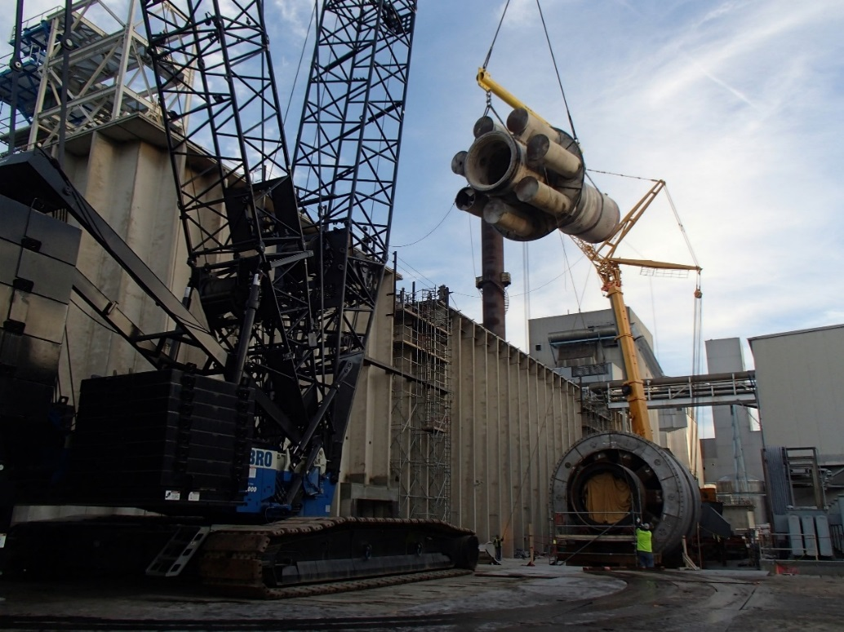
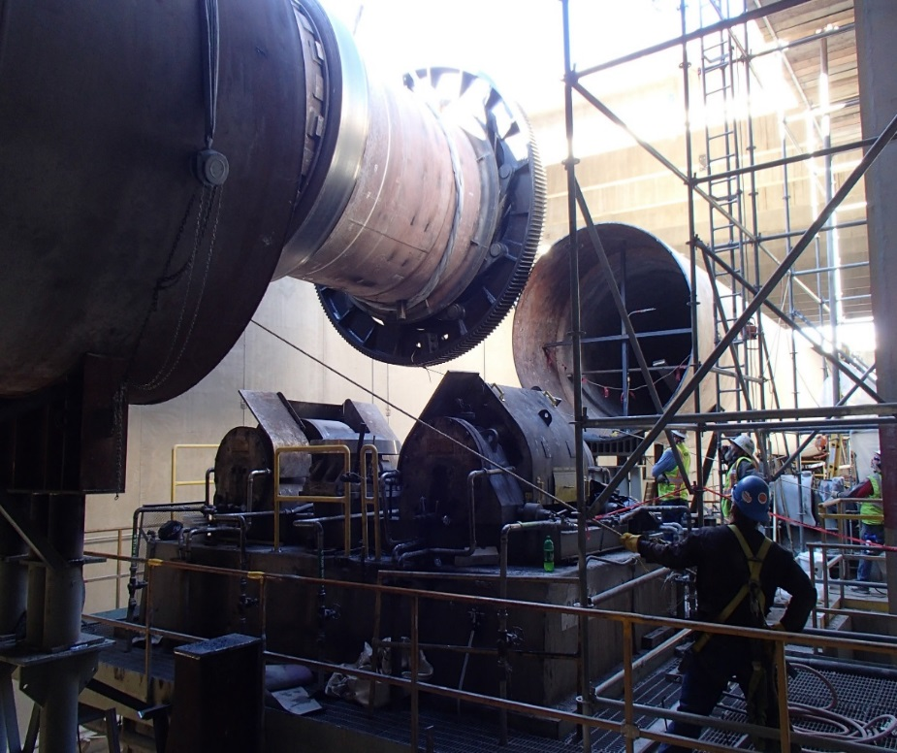
Periodic Inspections and Annual Mechanical Audits reduce catastrophic failures and costly repairs
.

Slide 15
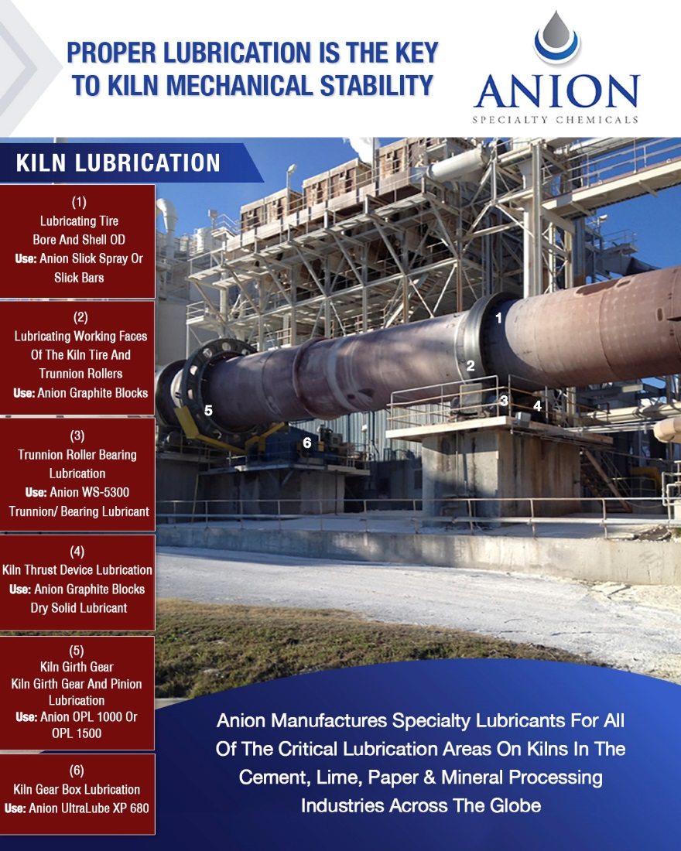
PROPER LUBRICATION & DILIGENT INSPECTIONS IS THE KEY TO KILN PREVENTATIVE MAINTENCE

